Slide 1
BILBOARD DETECTION
CSE 464/564
FINAL Presentation
Yunus KARA, Abdullah GÖKTÜRK
Project Advisor: Assoc. Prof. Dr. Habil Kalkan
January 2025

Slide 2
Used Techniques
Canny edge detection
Gaussian Smoothing
Morphological Operations (dilation)
Probabilistic Hough Transform
Flood Fill Algorithm
Binary Masking
Contour Detection

Slide 3
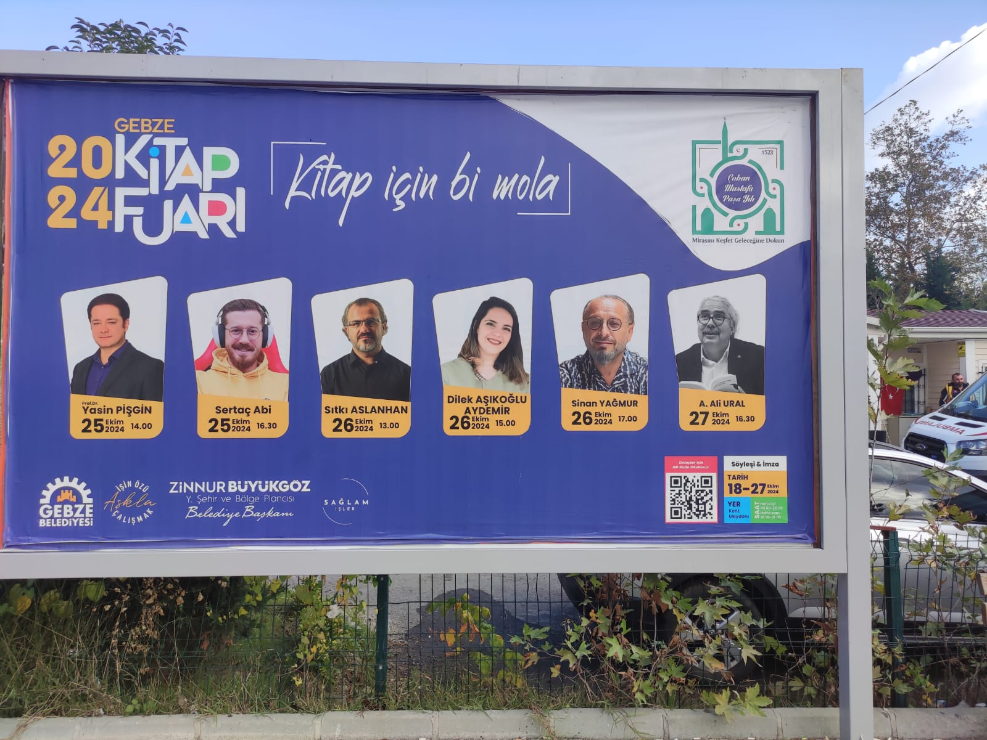
Our Test Image

Slide 4
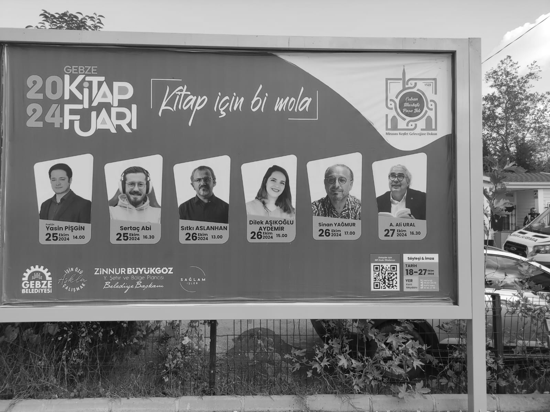
Grayscale the Image

Slide 5
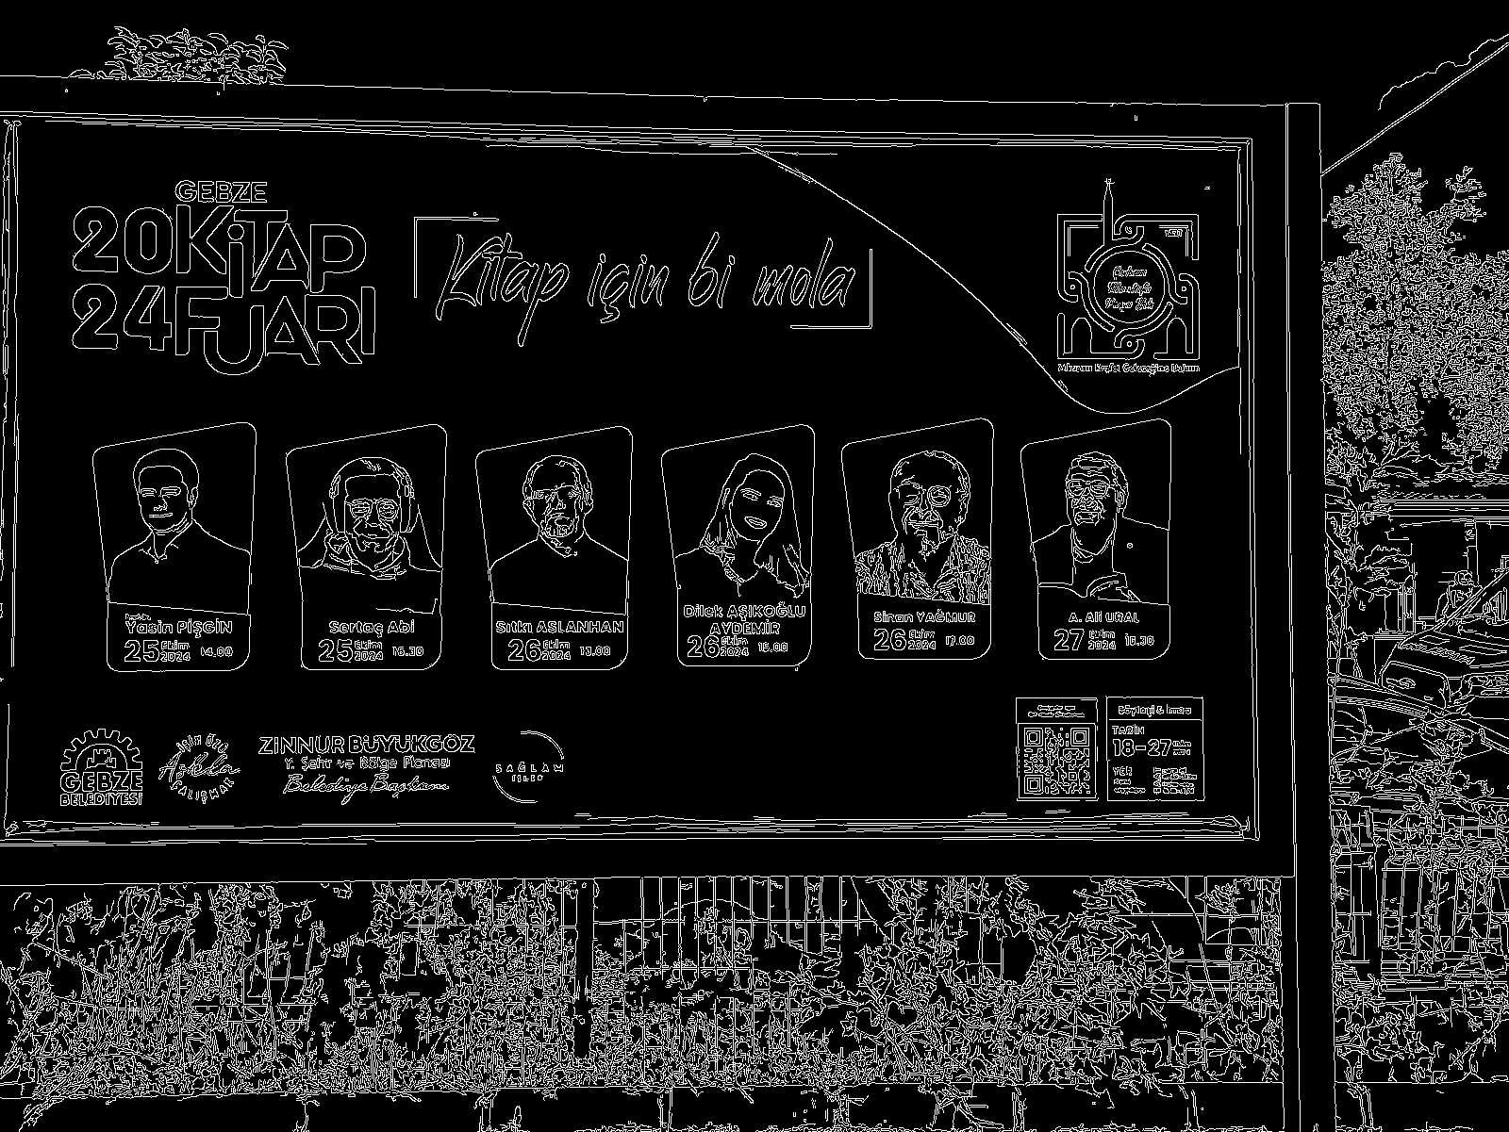
Canny Edge Detection

Slide 6
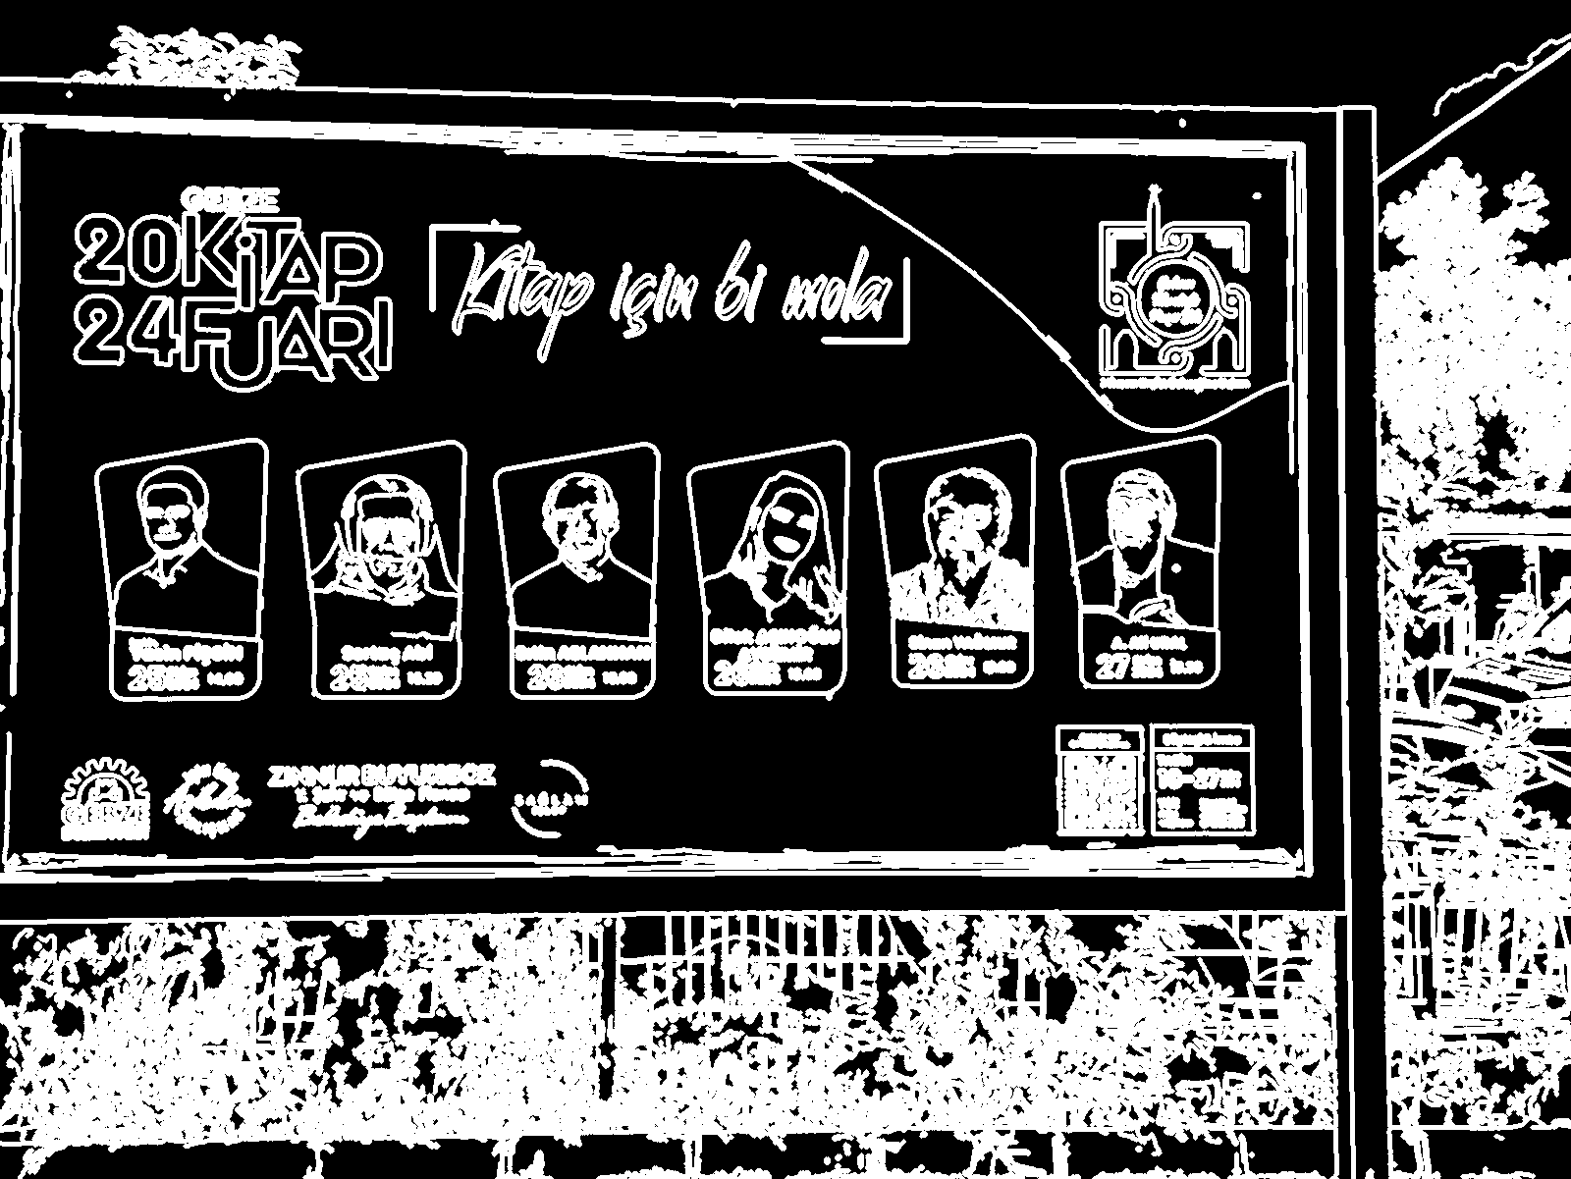
Dilation

Slide 7
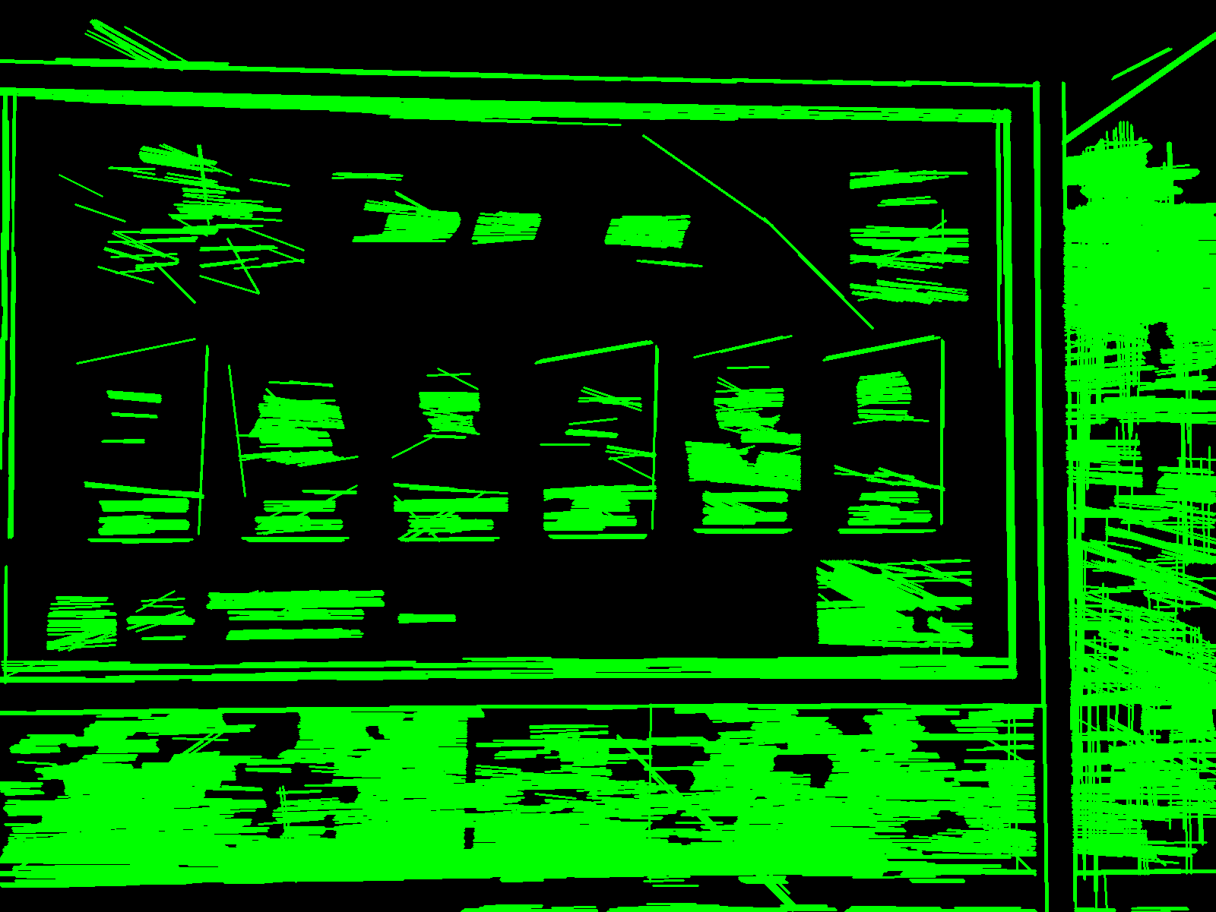
Probabilistic Hough Line

Slide 8

Dilation

Slide 9

Flood Fill

Slide 10
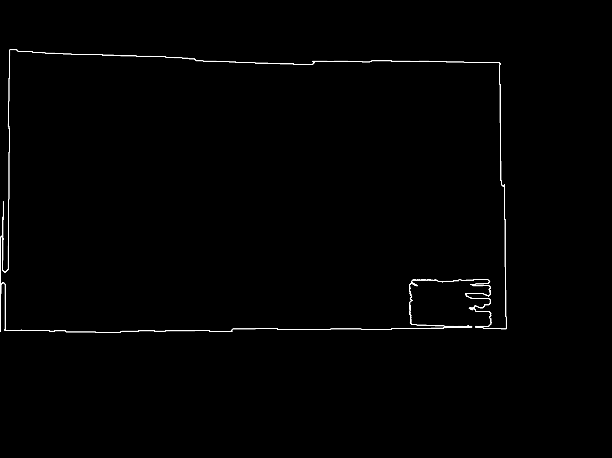
Active Contour

Slide 11
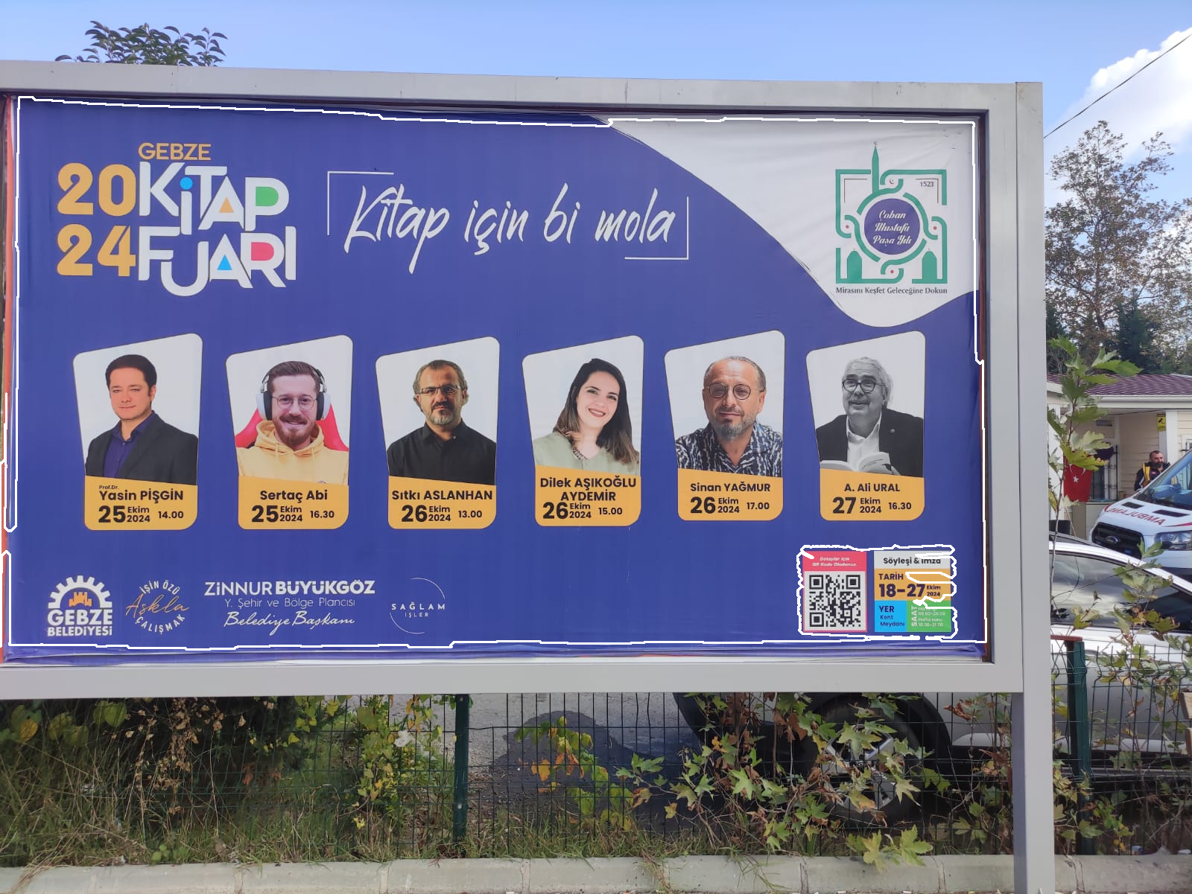
Final Output

Slide 12

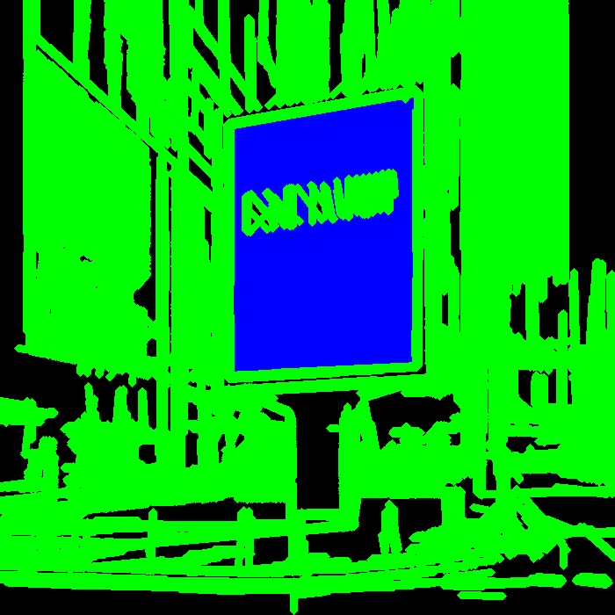
Other Bilboards

Slide 13
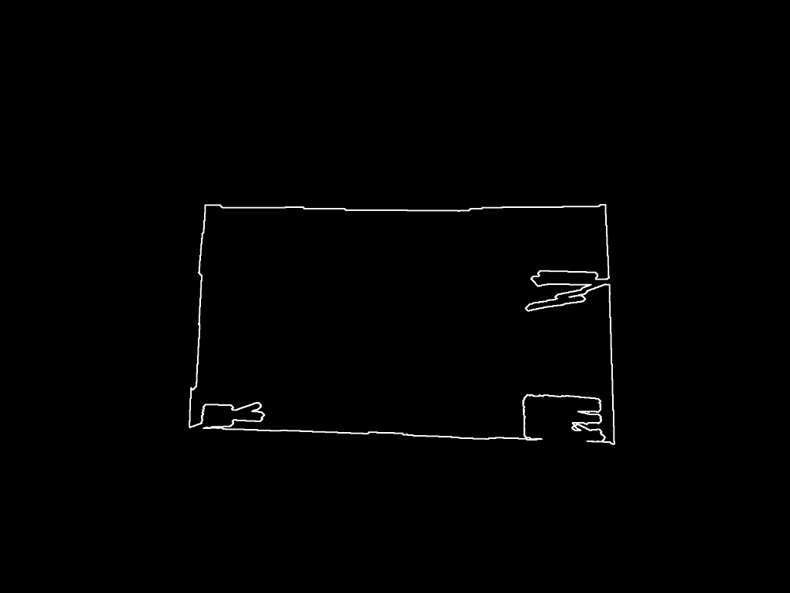
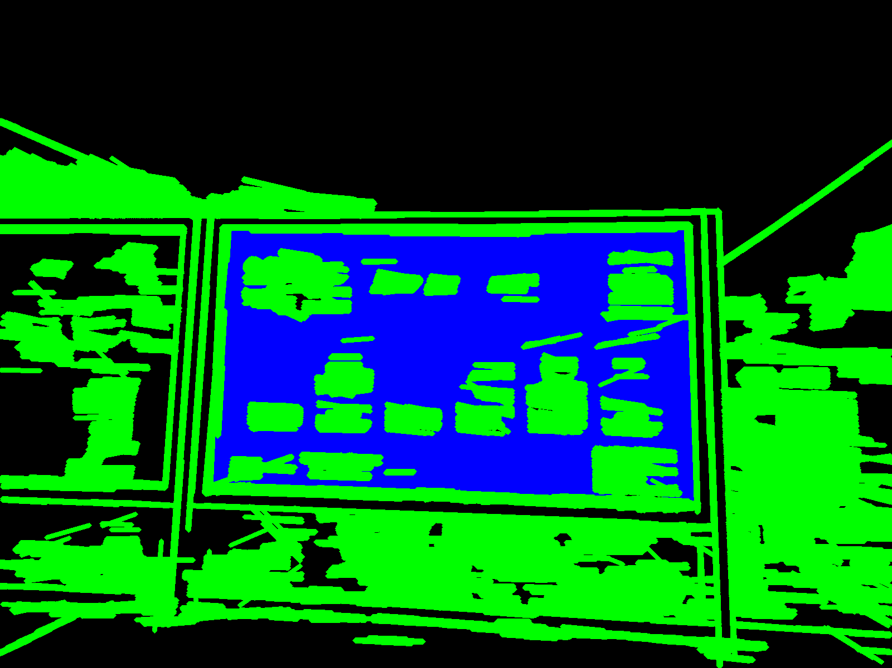
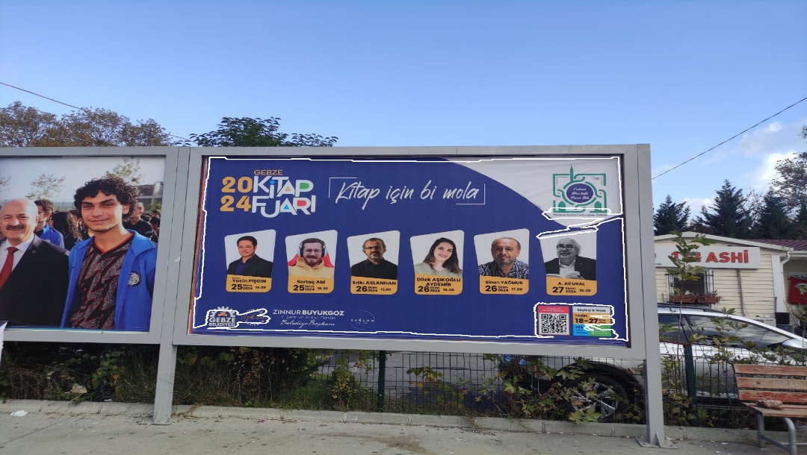
Other Bilboards

Slide 14

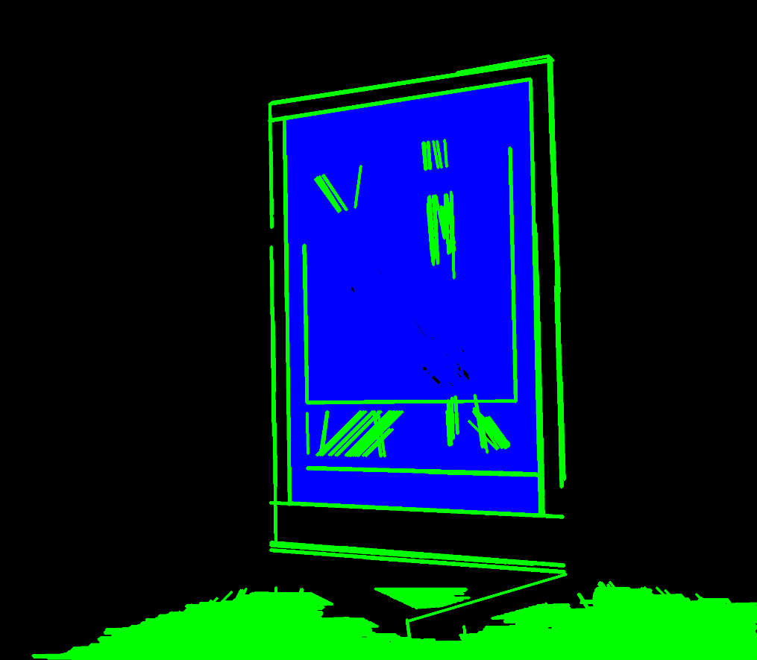
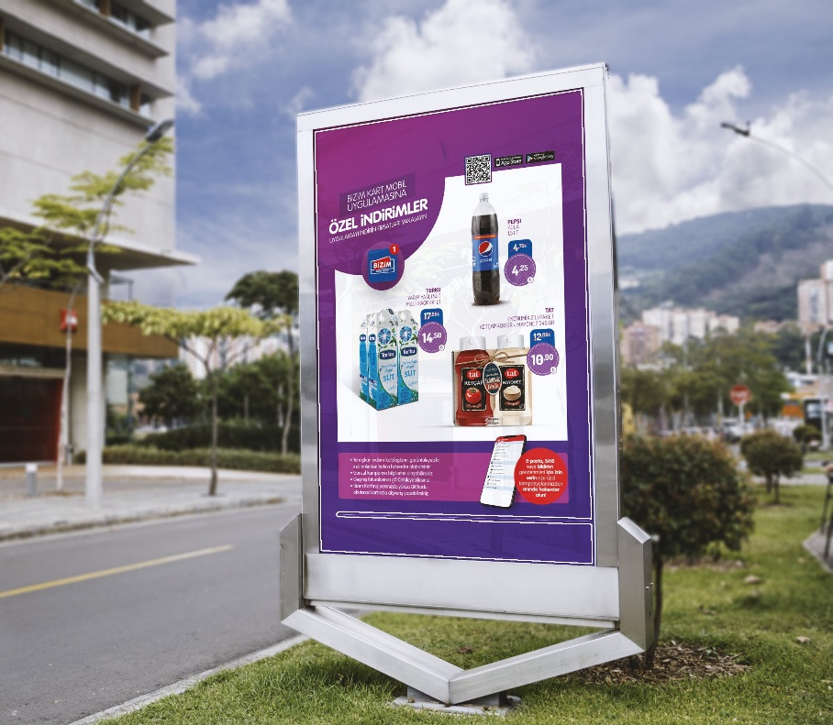
Other Bilboards

Slide 15

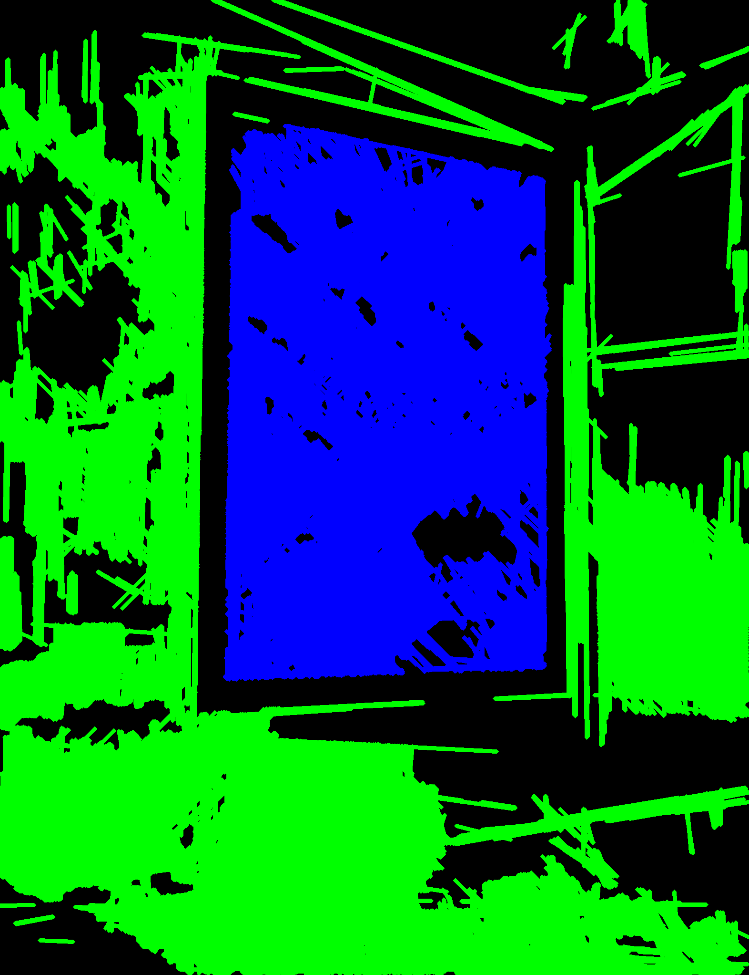
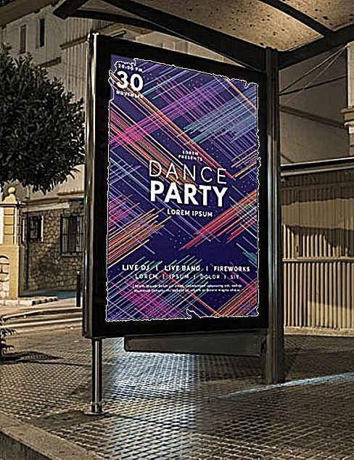
Other Bilboards

Slide 16
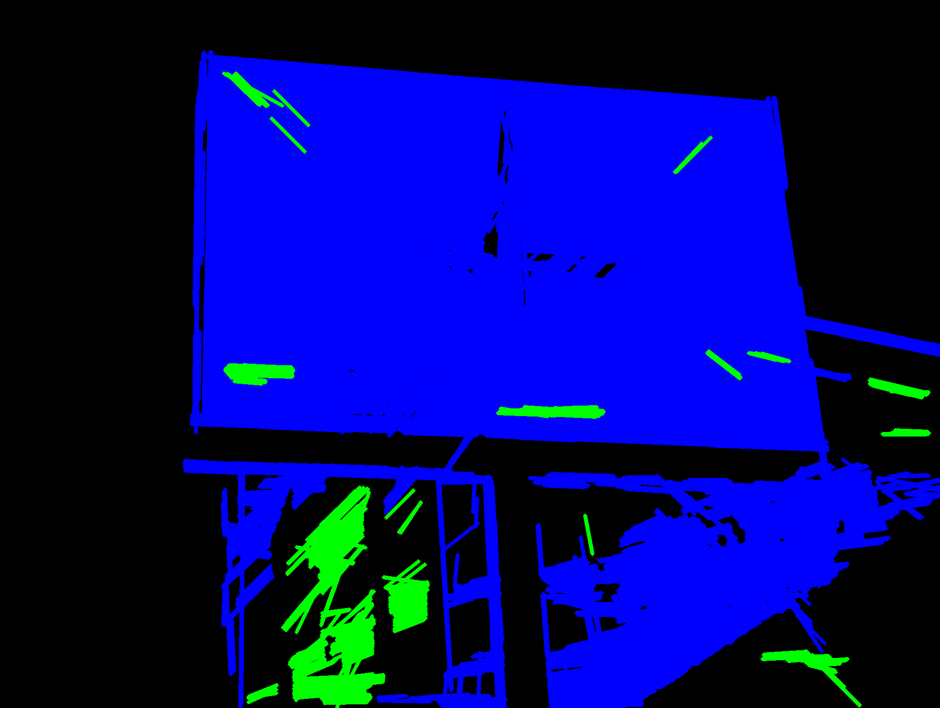
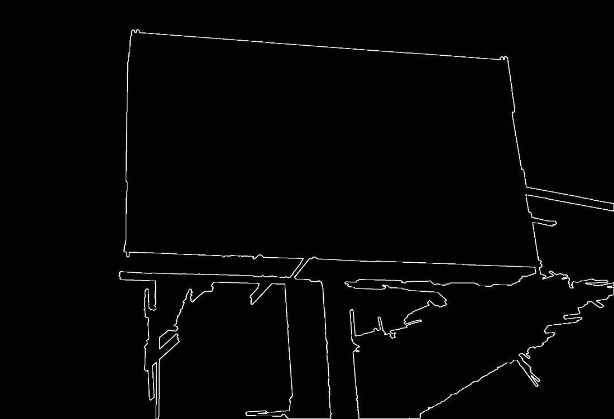
Failures

Slide 17
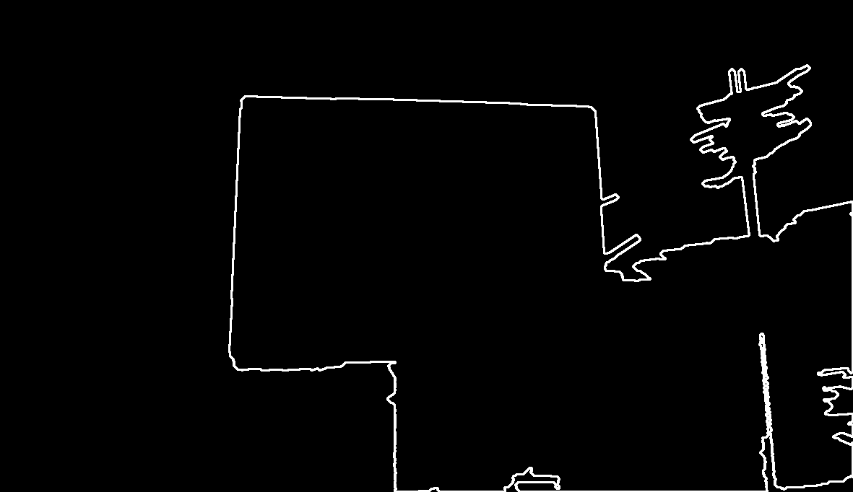
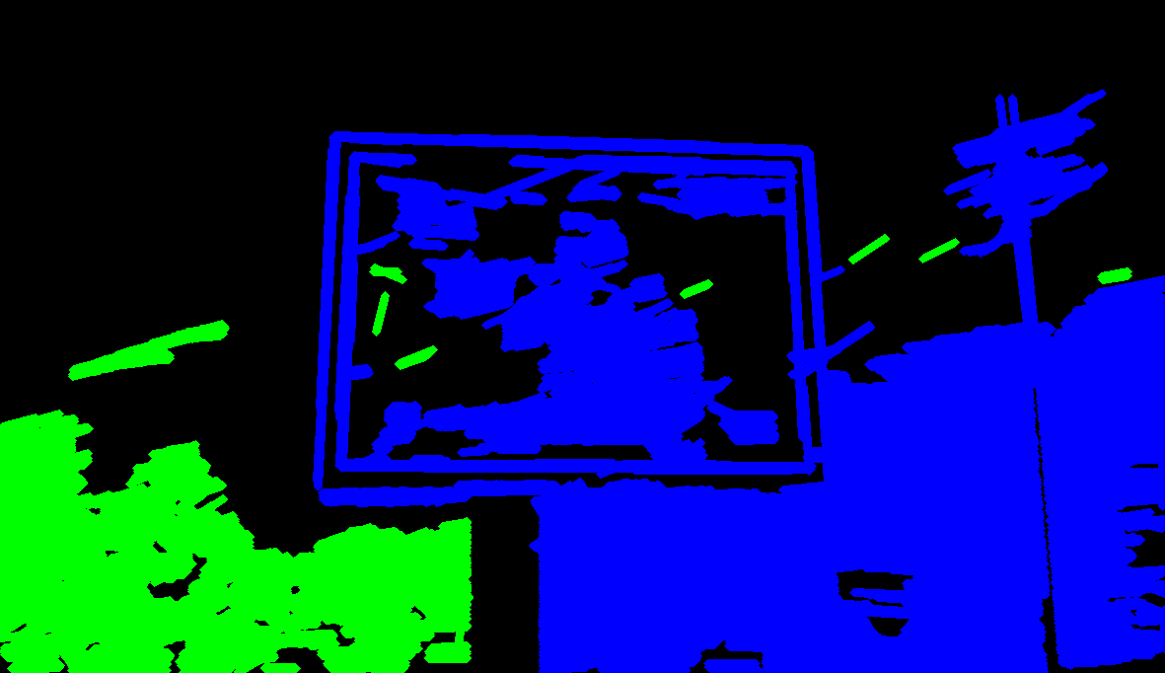
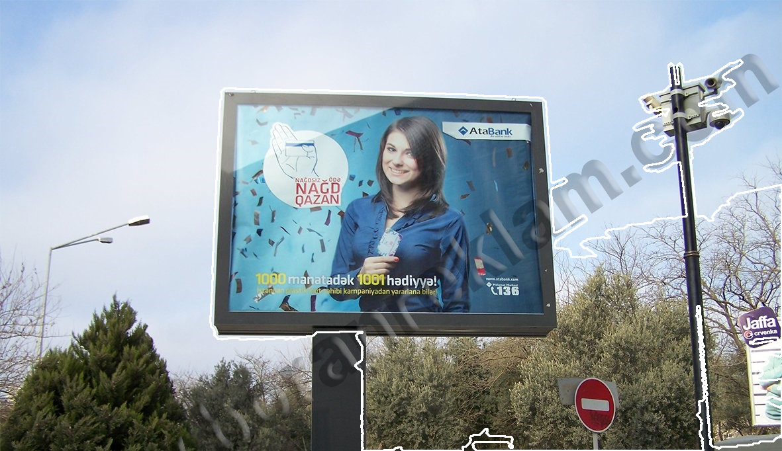
Failures

Slide 18
References
Canny, J. (1986). A computational approach to edge detection. IEEE Transactions on Pattern Analysis and Machine Intelligence, (6), 679-698.
OpenCV, “Image Filtering,” https://docs.opencv.org/4.x/d4/d13/ tutorial_py_filtering.html
Sobel, Irwin. (2014). An Isotropic 3x3 Image Gradient Operator. Presentation at Stanford A.I. Project 1968.
C. Galamhos, J. Matas and J. Kittler, "Progressive probabilistic Hough transform for line detection," Proceedings. 1999 IEEE Computer Society Conference on Computer Vision and Pattern Recognition (Cat. No PR00149), Fort Collins, CO, USA, 1999, pp. 554-560 Vol. 1, doi: 10.1109/CVPR.1999.786993. keywords: Voting;Monte Carlo methods;Error analysis;Stability criteria.
Kass, M., Witkin, A. , Terzopoulos, D. Snakes: Active contour models. Int J Comput Vision 1, 321–331 (1988).

